Slide 1
ABSTRACT
The problem that was intended to be solved by this project was the increasing number of potholes in almost all roads in the world. These are mostly caused by lack of proper municipal management, which makes them severe and deadly.
The model has an electronic system to detect the depth of any pothole encountered, and will dispense an equal volume of cement, freshly mixed then and there. The ARRV will stay there until the cement is dry and then move on.
The vehicle requires no assistance, other than a quick stop for recharging of batteries and refill of concrete powder/water. This technology will successfully lessen the number of potholes on the road and keep them safe along with preventing road accidents.

Slide 2
PROBLEM STATEMENT
A lot of small potholes are scattered across the roads of the world. It is a cause for many accidents and deaths, especially in India.
HYPOTHESIS
The ARRV would detect and fill potholes on the road without external aid.

Slide 3
BACKGROUND RESEARCH
The main reason for pothole formation, regardless of climatic conditions and other factors, is the negligence of local municipalities which causes small cracks in the asphalt to enlarge and worsen over time.
India is ranked worst in terms of road deaths. Deaths caused by potholes in 2016-20 were estimated to be 2,300.
Maintenance cost of a pothole of dimensions 1m² with 5cm depth is only ₹2500 in India (50$ in the US). Damaged roads can cost around ₹50,000 /km.
A lot of machinery, labour and time is required for maintenance, creating traffic congestion.
Deep potholes can inflict damage equivalent to that of a 35-mph accident
Damage to vehicles because of potholes cost around $1,000 during the lifetime of a vehicle

Slide 4
Automated Road Repair Vehicle
MATERIALS
MDF Board (Structure and Chassis)
Wheels
Water Tank (2)
Arduino UNO
DC Motor Single-Sided (4), Servo Motor
5V Relay
Ultrasonic Sensor
L293D Motor Driver
3.7V Li-Ion Batteries (2)
Water/Concrete Powder
Road Prop

Slide 5
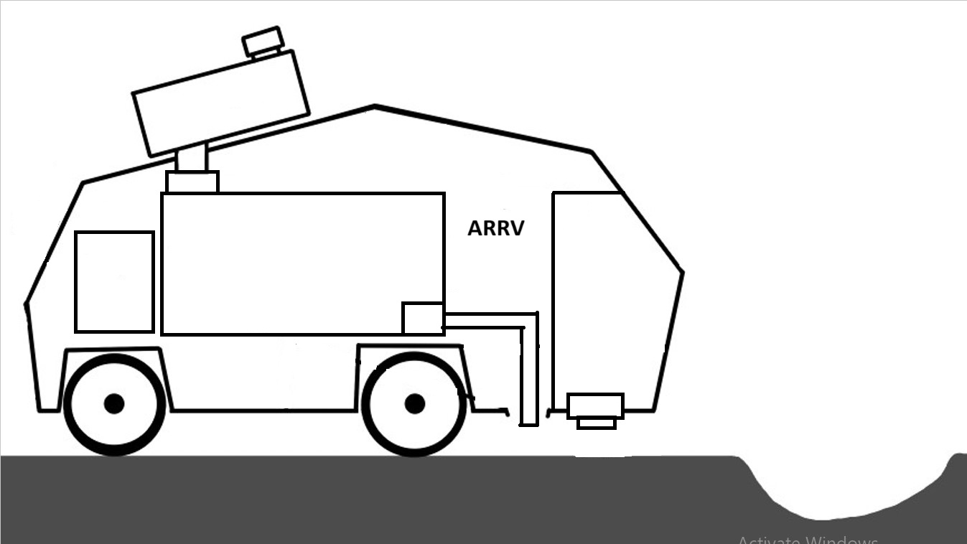
Water/Concrete Tanks
Servo – Controlled Valves
Tank
Cleaner
Electronic Housing
Mixing Tank
Pump
Ultrasonic
Sensor

Slide 6
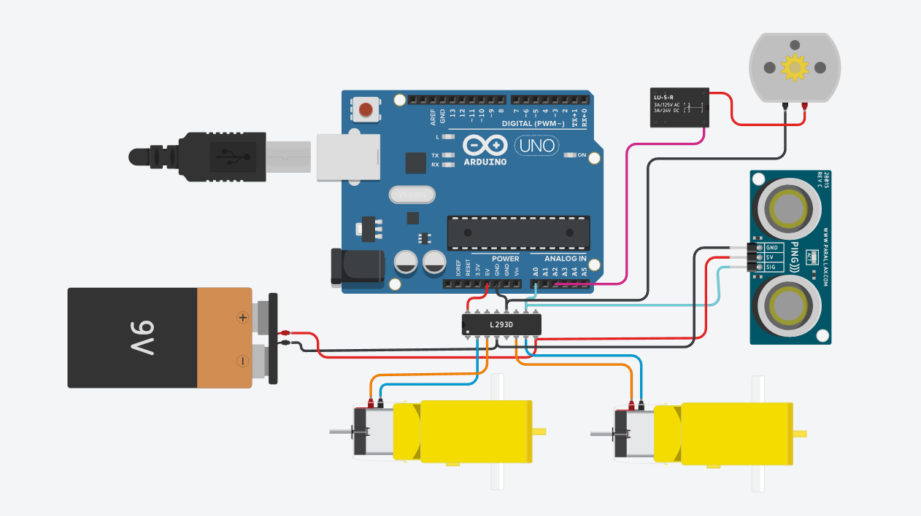

Slide 7
PROCEDURE
The ARRV encounters a pothole on the road prop. The sensor detects a drop in depth reading, and signals a stop.
The signal sets off the servo-controlled valves, which let through an appropriate proportion of concrete and water (depending on the depth detected into the mixing tank and close.
The rotor inside the mixing tank begins to churn the mixture for a short amount of time after which the pump turns on and begins to pour the mixture.
The mixture continues to pump until the sensor detects the rising level to be close to the road level.
After almost all of the mixture is poured, the tank cleaner similarly opens via a valve and lets in extra water which is pumped out so that the concrete doesn’t dry inside and prevent the pump and mixer from working.
The ARRV will stay for an amount of time decided by the amount poured.

Slide 8
RESULTS
During testing, around 250 mL of cement was released and filled into a pothole (4cm deep and with a diameter of 8cm)
Time taken for setting was 1 hour
CONCLUSION
Comparative study

Slide 9
 | Conventional Practice | Proposed Alternative
1 | Delayed Action: Roads need to be barricaded for repairs. This puts more stress on existing roads. More workforce | Swift Action: Pothole takes upto an hour to fix No manpower required
2 | Due to extensive nature of repairs, number and size of potholes increases until next repair. | The ARRV detects and fixes even small potholes, hence preventing them from worsening.
3 | Cost of repairs pertains to that of the entire road. | Only the materials required to fix a single pothole are used at a time.

Slide 10
FUTURE DIRECTIONS
The actual ARRV will be about the size of an average car – 2 meters in length and 1.5 meters wide
The vehicle will operate at night to avoid interfering with traffic
A prominent blue light will be mounted on top of the ARRV while it waits in front of the pothole, signaling its presence.
It materials will last up to 10 km after which it would stop, signalling a refill.

Slide 11
